Slide 1
Olympic Dashboard Data Analytics and Visualization using Power BI
Presented by:
Rohit Jain

Slide 2
Project Brief
Data Analytics and Visualization using Power BI involves utilizing Microsoft’s robust business intelligence tool to analyze, visualize and share insights from data. Power BI connects to various data sources, such as Excel, SQL databases, cloud services, and APIs, allowing seamless integration and aggregation. It offers powerful tools for cleaning and transforming data through Power Query, enabling users to shape datasets for analysis. With its data modeling capabilities, users can establish relationships between tables, create calculated columns and use DAX (Data Analysis Expressions) to derive meaningful insights.
2

Slide 3
Technologies/ Tools to be used
Technologies to be used:
Power BI Desktop Power Query
Standard laptop or desktop computer
Internet connection for cloud collaboration
Tools Power BI :
Microsoft Excel (for data pre-processing)
SQL (if required for database connection)
Jupyter Notebook
3

Slide 4
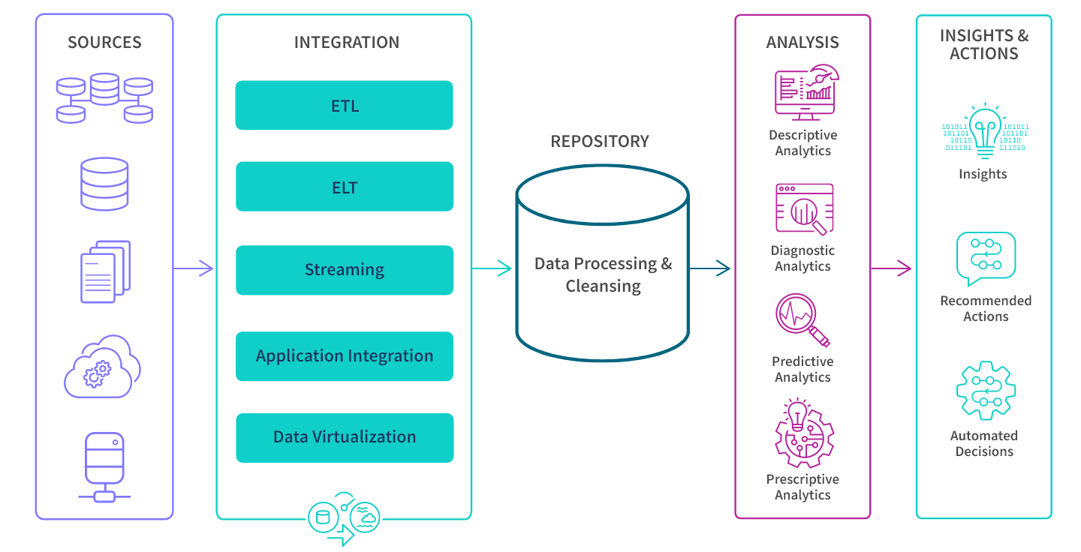
Context Diagram (Overall Project)
4

Slide 5
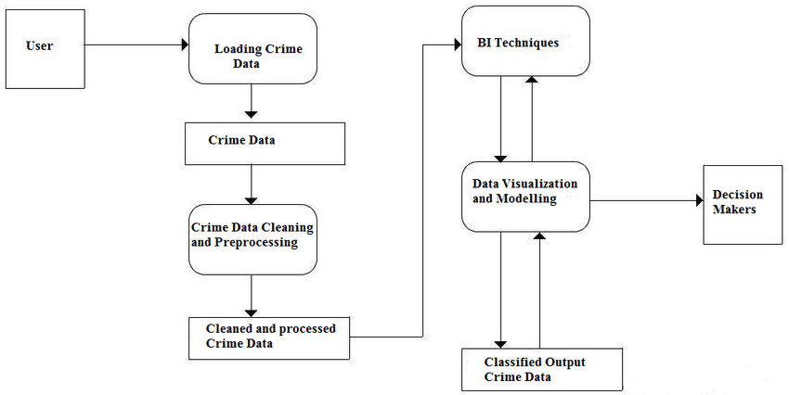
Data Flow Diagram (DFD)
5

Slide 6
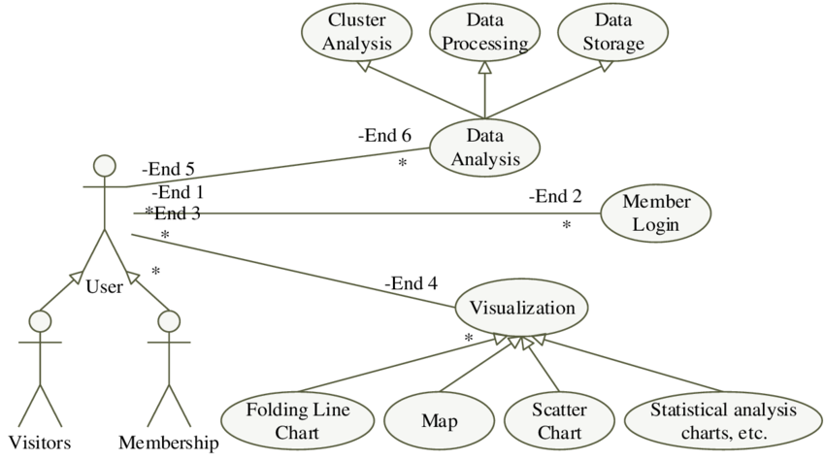
Use Case Diagram
6

Slide 7
\
Advantage of The Project
Real-Time Insights: Instantly track metrics and respond quickly to changes.
Predictive Analytics: Forecast future trends using AI and machine learning.
Automation and Integration: Streamline workflows and connect with other tools seamlessly.
Custom AI-Powered Insights: Uncover hidden patterns with advanced AI features.
Scalable for Big Data: Efficiently manage large datasets with cloud-based solutions.
Enhanced Security and Compliance: Protect sensitive data with role-based access and compliance tools.
7

Slide 8
References, if any
https://link.springer.com/book/10.1007/978-3-031-15266-5
https://link.springer.com/referencework/10.1007/978-981-19-9438-8
https://www.geeksforgeeks.org/data-analysis-tutorial/
https://www.youtube.com/@The-Developer-BI
https://www.microsoft.com/en-us/power-platform/products/power-bi
8

Slide 9
THANK YOU

